Slide 1

Getting ready to start training
Module two:
Understanding impacts of trauma for a child or young person

Slide 2
Getting ready to start
Training modules
Each participant will be assessed throughout the four modules on the following learning objectives:
Module one – context of foster care - ✓ completed
An understanding of the process of how children and young people come into care and the impact of this process, and why children and young people require a care arrangement.
Module two – understanding impacts of trauma for a child or young person –
An understanding of trauma and related behaviours for a child or young person who is in care arrangement.
Module three – early days in a care arrangement
Developing knowledge and skills required to meet the physical, emotional and social needs of children and young people in care and an understanding of the importance of participation by children and young people and their families in decision making.
Module four – Quality care & working together
Have an understanding of the importance of partnerships between children, their families, foster and kinship carers and workers, (both in the government and non-government sectors), and their roles and responsibilities when working together as a team.

Slide 3
Module two
Understanding impacts of trauma for a child or young person
Learning outcomes – module two
At the end of this module you will be able to:
Understand the basic developmental stages of childhood and adolescence
Understand the experience of abuse and harm and how these impact on children
Understand what attachment means for a child, and how separation impacts on attachment
Identify the types of losses that may be experienced by children who come into care and by birth family members
Understand positive behaviour supports and options for managing high risk behaviours

Slide 4
Understanding impacts of trauma for a child or young person
  Understanding trauma for children and young people – 30 mins
  How trauma may impact stages of childhood development – 40 mins
    Attachment
    Stages of Grief and Loss
  The experience of abuse – 40 mins
    Sexualised behaviours
    Self Harm
    Responding to disclosures
  Responding to challenging behaviours – 30 mins
    Positive behaviour supports
    Managing high risk behaviours

Slide 5
Trauma
Children in care may not behave or respond how we might expect due to:
Exposure to abuse and neglect
Poor attachments to primary carers or significant others
Experiences of grief and loss

Slide 6
Trauma
The impact of these experiences are sometimes:
Difficulties with emotions – angry, anxious, incorrect emotional response for situation, shame
Difficulties with social situations – fear, distrust, avoidance, isolation, test people
Difficulties with relationships – problematic relationships, avoids intimacy, fear rejection, limited positive attachments
Developmental delays – different stage than peers
Challenging behaviours – self harm, hostile, aggressive

Slide 7
Trauma
What can carers do?
Support and empathise with the child
Listen carefully to the child
Encourage the child to participate in decision making
Be consistent and committed to the child
Understand attachment, grief and loss
Help maintain important relationships to the child
Positive role model
Teach
Read, train, learn and ask
Stay calm and seek support

Slide 8

How trauma may impact stages of childhood development

Slide 9
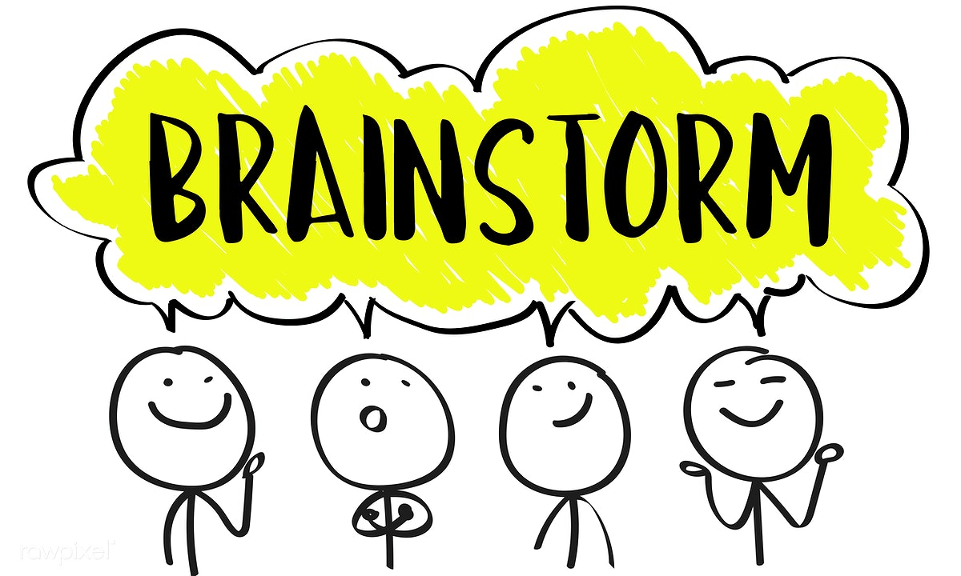
Developmental stages
What ‘milestones’ do you know?
How can you help a child meet developmental levels?

Slide 10
Attachment
A bond – cooing, smiling.
Attachment is more than a bond it is a relationship - the development of nurturing, soothing and trusting relationship.
Attachment is where the child feels and finds safety and security in the context of the relationship.
Children and young people can and do form attachment relationships with other people throughout their lives.
The best outcomes for children occur when foster carers really commit to developing an attachment relationship with the child.

Slide 11
Responding to Attachment Issues

Slide 12
Attachment

Slide 13
Insecure Attachment Styles

Slide 14
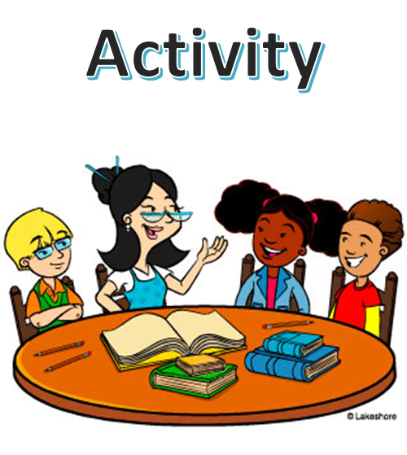

Slide 15
Attachment – what can carers do?
Preserve existing attachments – with family, friends, school and cultural and community members
Stay committed to the child and your relationship – be there through the tough times and beyond the age of 18 years
Be consistent, reliable and predictable – model and teach
Engage in healthy relationships – promote friendships, join a sports team
Try to understand why the child is behaving this way – work with their issues as well as their behaviour
Respond according to the child’s emotional level
Don’t take their behaviour personally
Celebrate achievements, no matter how small

Slide 16
Stages of Grief and Loss
Emotion | Reaction
Shock | Feel numb
Denial | Pretend its not happening, avoid thinking about it by keeping really busy
Anger | Why me? Anger or making people around us angry
Deep sadness | Cry over all sorts of things, feel really low all the time
Acceptance | Accept what is happening and ability to move on
Children do not automatically move through each stage.
Children may move in or out or even between stages depending on the situation or events they are experiencing at the time.

Slide 17
Impact of grief and loss
Disrupted bonds to parents and family
Strong defence of parental behaviour
Fantasising about home
Self harm
Depression
Feeling worthless and low self esteem
Fear of getting close to others
Running away from carer’s home

Slide 18
Grief and loss – what carers can do?
Maintain the child’s bonds with siblings, parents and significant others
Build a relationship through structure, nurture and boundaries – relearn relationships
Help them make sense of their experience – it wasn’t their fault
Develop positive stories about themselves
Help them connect with their talents, interests and skills

Slide 20

The experience of abuse

Slide 22
Sexual abuse – impacts on children
Pre occupation with age inappropriate sexual behaviour and persistent acting out
Persistent sexual themes in play, artwork or stories
Shame
Sleep disturbance
Inappropriate, promiscuous or flirtatious interactions
Inappropriate sexually aggressive play
Self harm
Substance misuse and abuse

Slide 23
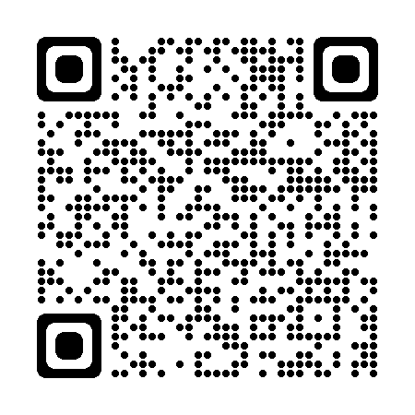
Sexual abuse – what carers can do?
Listen carefully
Define household privacy rules
Teach assertive and self protective skills
Discuss the need for sexual abuse counselling
Consider the level of supervision required
Useful resources to assist with sexual and reproductive health can also be found on the True website, www.true.org.au.

Slide 24


Slide 25
Self Harm
Things to look out for
Physical Changes:
Loss of interest and pleasure in all things
Loss of physical activity
Loss of interest in personal hygiene
Major changes in sleeping patterns –too much or too little
Sudden and extreme changes in eating habits – either loss of appetite or increase in appetite. Losing or gaining weight
Behaviours:
Unexplained crying
Emotional outbursts
Alcohol or drug misuse
Uncharacteristic risk-taking or recklessness
Fighting and/or breaking the law
Withdrawal
Quitting activities that were previously important
Prior suicidal behaviour
Giving away possessions, especially those that have special significance for the person.

Slide 26
Self Harm
Things to look out for cont.
Conversational Signs:
Examples:
Escape – “I can’t take this anymore”
No future – “What’s the point? Things are never going to get any better”
Guilt – “It’s all my fault, I’m to blame”
Alone – “I’m on my own… no one cares about me”
Helpless – “Nothing I do makes a bit of difference”, “Things just happen to me”
Talking about suicide or death
Feelings:
Desperate
Sad
Angry
Ashamed
Worthless
Powerless
Lonely/Isolated
Disconnected
Hopelessness

Slide 27
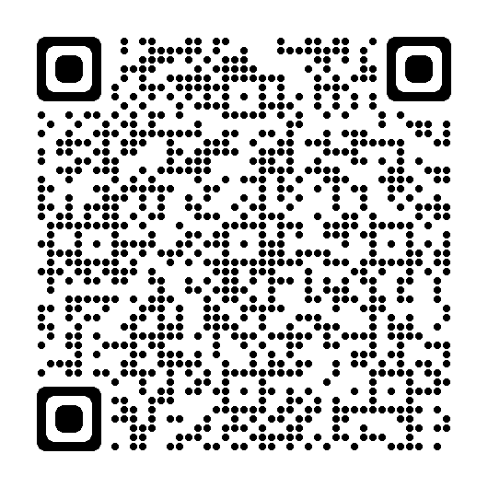
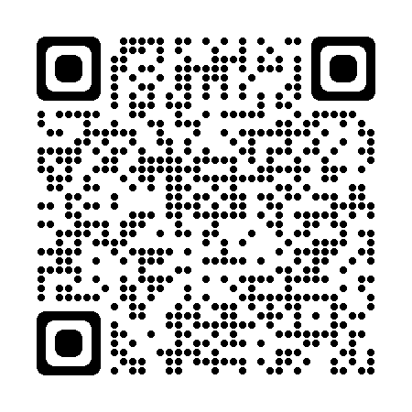
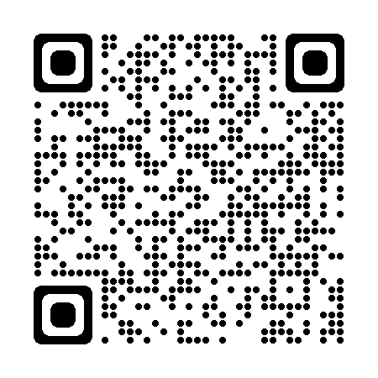
Self harm – What carers can do?
Act straight away and talk to the child or young person
Be open with your concerns, because you wish to keep them safe you will need to talk to others
Take any threats, suicide talk or actions seriously
Contact your CSO immediately to discuss your concerns if during work hours, or contact CSAHS if after hours
Ask for strategies to help talk to the child
Talk openly with others - CSO, school staff, child’s counsellor
Use resources available - Foster carer support line, Information for existing carers, LIFE – Living is for everyone and Beyond Blue
Information for existing carers
LIFE – Living Is For Everyone
Beyond Blue

Slide 28
Responding to Disclosures
Be a listener not an investigator - encourage children to talk in their language and ask just enough questions to act protectively.
Ask “can you tell me more about that?” and “what happened next?”. Do not conduct any form of interview with the child.
As soon as possible after the disclosure make written notes including when and where the disclosure took place. Pay attention to body cues such as changes in their behaviour, feelings, and words they used.

Slide 29
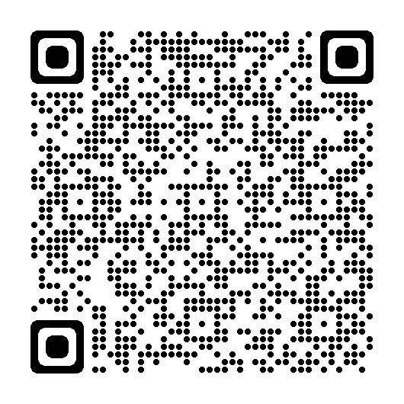
Responding to Disclosures
Be calm and reassure the child or young person that it is alright to talk about this and they have not done the wrong thing.
Listen carefully and demonstrate that you are taking them seriously.
Tell the child or young person that you will need to talk to their CSO. You should engage the child or young person in this – e.g. say this information needs to be shared with someone and ask how you can both do this.
It is vital to call your CSO even if you do not have all the details.
From July 5, 2021 it is an offense for any adult not to report sexual offending against a child by another adult to police. This means that all adults have the responsibility to report sexual offences against children to police, unless they have a reasonable excuse not to – scan the QR code to the right for more information.

Slide 30


Slide 31
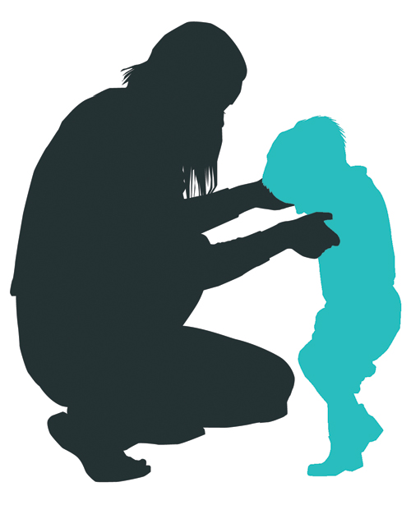
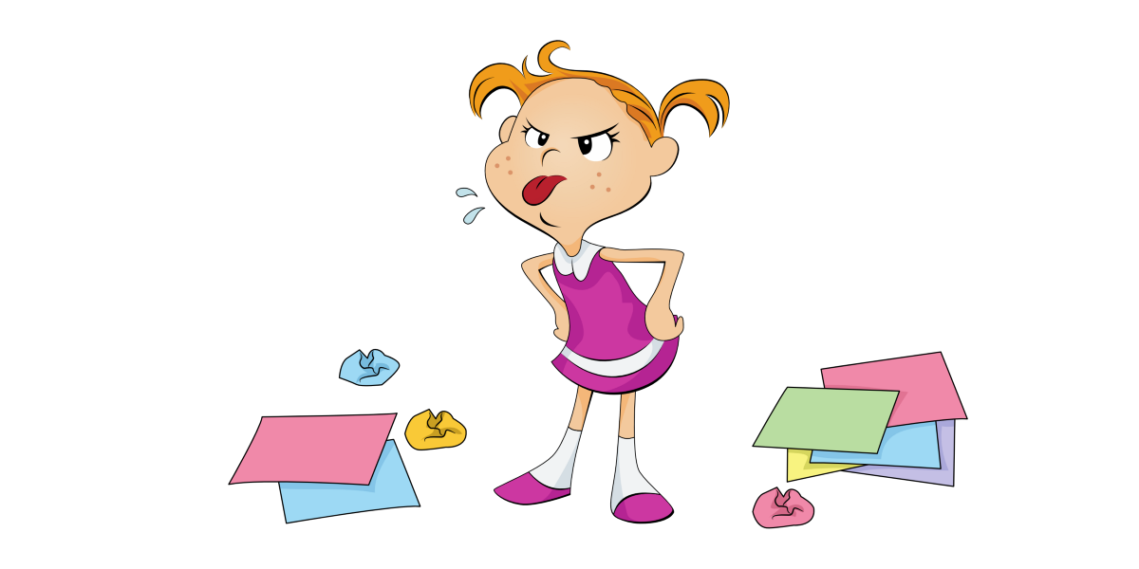
Responding to challenging
behaviours

Slide 32
Positive behaviour support
All children and young people need to be supported to grow, develop skills and to participate in their social, school and community life.
For children in care arrangements, carers often provide the majority of that support, which should be strengths-based, modelled on positive behaviours and which should incorporate appropriate discipline within a safe and caring relationship.
Some children in care will have challenging or at-risk behaviour. This behaviour:
  is typically not seen in children or young people of a similar age
  is inappropriate to the context in which it occurs
  is of such frequency, intensity and duration that it presents risk to the child or young person or others
  has a negative influence on the child or young person’s quality of life such as restricting learning opportunities, limiting access to everyday community activities or impacting negatively on relationships.

Slide 33

Challenging behaviours
Why may children in care exhibit more extreme patterns of behaviours
What may be some of these behaviours?

Slide 34
Positive behaviour support
At-risk or challenging behaviour is often related to environmental factors, such as interpersonal relationships, physical environment, responses from others and the way in which services are delivered
Child Safety will support cares to:
  focus on understanding the purpose of the behaviour and increasing positive behaviours through skill development rather than punishing negative behaviours.
  uses proactive strategies (rather than reactive or crisis driven) that overtime reduce children and young people engaging in at risk or challenging behaviour.

Slide 35
Positive behaviour support
Children with challenging or at-risk behaviour will have a Positive Behaviour Support Plan – ask the CSO if the child or young person has one and what strategies are suggested
Positive behaviour support plans usually have referrals to specialist services – ask the CSO if there are referrals and how to assist at home
Case work should include support and advice to carers – how to de escalate situations, support strategies, re direction

Slide 36
Positive Behaviour Support Plans
Positive Behaviour Support plans will support a child or young person and their behaviour, including:
Primary preventative strategies that aim to change the environment and improve quality of life to reduce the need for the child or young person to engage in at-risk or challenging behaviour. These strategies include building strong relationships, recognising positive behaviours rather than negative ones, focussing on strengths, clear and consistent boundaries and assisting with problem solving.
Secondary strategies that aim to alleviate the situation when behaviours are low risk and to prevent the behaviour from escalating. They are used when there are early warning signs of at-risk or challenging behaviour.
Non-aversive reactive strategies that aim to bring about resolution and return to safety including de-escalation strategies.

Slide 37
Positive Behaviour Support Plans
NDIS
For children and young people with a disability who engage in at-risk or challenging behaviour, their National Disability Insurance Scheme (NDIS) plan will include funding for:
the development of a PBS Plan and staff training to implement the plan
funding for other allied health funding as required to support the assessment and development of a PBS Plan and skill development e.g. occupational therapy, speech therapy.
Carers and direct care staff will also discuss any concerns about a child or young person’s behaviour during the NDIS planning or review meeting.

Slide 38
Positive Behaviour Support
Prohibited practices
Prohibited practices are:
unlawful and unethical practices which present a high risk of causing high level discomfort and trauma.
Any action which is contrary to section 122 of the Act because it frightens, threatens or humiliates a child or young person
Prohibited practices must not be used in responding to the behaviour of children in care.
The use of these and the following responses must be reported to the Child Safety Service Centre or Child Safety After Hours Service Centre within 24 hours of the incident occurring.

Slide 39
Positive Behaviour Support
Examples of prohibited practices
corporal punishment
unethical practices to modify a child or young person’s behaviour
planned use of physical restraint
planned use of restriction of access to items (environmental restraint)
containment (environmental restraint)
seclusion
chemical restraint
mechanical restraint
aversive strategies

Slide 40
Positive Behaviour Support
Examples of prohibited practices
Restraints used as intended (such as car seats, safety harness in prams and change tables) are not prohibited. However these items should be monitored to ensure that they:
  do not convert to being used as a mechanical restraint, for example, a stroller with straps applied to secure the child safely when used should not be used at home to restrict their movement.
  are not used in a way to punish a child or used for lengthy periods of time for example placing a child in a cot for lengthy periods as a form of discipline.

Slide 41
Positive Behaviour Support
Examples of prohibited practices
Prohibitive practice do not include steps taken by a carer or member of direct care staff in a parenting role to discipline and respond to developmentally appropriate behaviour.
For example the short periods of ‘time out’ type strategies consistent with accepted parenting practices such as those promoted through the Triple P Program.
Care must be taken that these strategies do not continue as the child becomes older and that they do not become seclusion.

Slide 42


Slide 43
Positive Behaviour Support
What can carer’s do?
Ask about the child’s positive support plan
Be a good role model - show what you expect
Listen and ask questions - what will make you feel better?
Use positive reinforcement - encourage shared learning
Focus on the child’s strengths not behaviour
Establish clear family routines
Prepare yourself for difficult situations - avoid a battle, don’t prove who’s in charge
Set limits and stick to them - be consistent with rules and boundaries
Use available resources - foster carer support line, Information for existing carers webpage, foster and kinship care worker, Evolve, training

Slide 44
Managing high risk behaviour
While children and young people who regularly engage in at-risk or high risk behaviour will have Positive Behaviour Support (PBS) Plans that provide strategies to assist with responding to the challenging or at risk behaviour early in the escalation where behaviours present lower risk.
These PBS will manage the use of any restrictive practices.
Restrictive practices are any intervention that impacts on the rights or freedom of movement of a person with the primary purpose of protecting the person or other people from harm.
Restrictive practices do not facilitate long-term behaviour change and must not be the sole method used to manage a child or young person’s behaviour.
For any restrictive practice there must be a strategy to reduce and minimise its ongoing use.

Slide 45
Emergency use of restrictive practices
At times, children and young people may engage in behaviours of such intensity, frequency and duration they present immediate risk to themselves and/or others without intervention.
In such circumstances, it may be necessary for carers to respond quickly to take emergency action.
In these limited instances, the emergency use of a restrictive practice may be required to manage risk.

Slide 46
Guiding principles for the emergency use
of restrictive practices
The situation in which an emergency use of restrictive practices may be appropriate is when:
the child or young person is behaving in a way that poses immediate foreseeable risk of harm or actual risk of harm to themselves or others
the practice is reasonable in all the circumstances of the behaviour
where there is no less restrictive measure available to respond the child or young person’s behaviour in the circumstances.
paramount consideration must be given to the best interests of the child.

Slide 47
Emergency use of restrictive practices
What can we do/ what does it mean?
Emergency responses to manage high risk of immediate harm (risk management response)
Emergency use of physical restraint, except for prone and supine restraints and basket holds which are always prohibited practices
Emergency removal of an item
Minimum force
Use of a restrictive practice must be reported to a CSSC or CSAHSC within 24hrs.
The requirement to report the emergency use of a restrictive practice does not include actions taken by carers and direct care staff in the context of age and developmentally appropriate parenting, for example removing scissors from a toddler.

Slide 48
Discipline vs punishment
What are appropriate discipline methods?

Slide 49
Module two: Understanding impacts of trauma for a child or young person
Learning Outcomes
Understanding the basic developmental stages of childhood and adolescence
Understanding the experience of abuse and how it impacts on children
Understanding what attachment means for a child, and how separation impacts on attachment
Identifying the variety of losses that may be experienced by children who come into care and by birth family members
Understanding and responding to challenging behaviour

Slide 50


