Slide 1

Getting ready to start training
Module four: Quality care – working together

Slide 2
Getting ready to start - Training modules
Each participant will be assessed throughout the four modules on the following learning objectives:
Module one – context of foster care - ✓ completed
An understanding of the process of how children and young people come into care and the impact of this process, and why children and young people require a care arrangement.
Module two – understanding the past for a child or young person - ✓ completed
An understanding of trauma and related behaviours for a child or young person who is in care arrangement.
Module three – early days in a care arrangement ✓ completed
Developing knowledge and skills required to meet the physical, emotional and social needs of children and young people in care and an understanding of the importance of participation by children and young people and their families in decision making.
Module four – Quality care & working together
Have an understanding of the importance of partnerships between children, their families, foster and kinship carers and workers, (both in the government and non-government sectors), and their roles and responsibilities when working together as a team.

Slide 3
Module four: Quality care- Working Together
Learning outcomes- module 4
At the end of this module you will be able to:
Demonstrate how all key players can work together - including what to do when things go wrong
Demonstrate an understanding of carer support options
Demonstrate an understanding of transition to independence
Demonstrate an understanding of the complexities of when a care arrangement comes to an end

Slide 4

Module four: Quality care- Working Together
Working in partnership
  Statement of Commitment
Standards of Care (SOC)
  What is a Standard of Care
  What is a Harm Report
Carer supports
  General Support
  Financial Support
  Changes in Carer Circumstances
Guest panel
Transition to Adulthood (T2A)
  What is T2A?
  How can you support T2A as a carer?
  Resources
Saying goodbye
  When a child or young person moves on
Conclusion and Evaluation

Slide 5
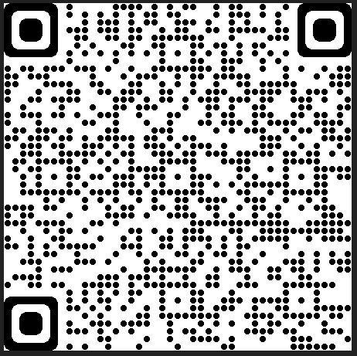
Working in Partnership
Statement of Commitment
Child Safety and the Qld peak child protection agencies (partner agencies) through the Statement of Commitment have made a commitment to work together with you to:
Make a difference in the lives of children and young people
Ensure the safety, belonging and wellbeing needs of the children and young people in your care are met
Ensure Aboriginal and Torres Strait Islander children and young people in care maintain their cultural identity and relationship with their family and community
Do our best for you so you can do your best for the children and young people in your care
Build a good relationship that will help us work together to get the best outcomes for children and young people, even when we disagree or see things differently
Uphold the human rights of children and young people in your care.
The Statement of Commitment can be found at the link below or via the QR code to the right.
Statement of Commitment - foster and kinship carers of Queensland (www.qld.gov.au)
Statement of Commitment
QR code

Slide 6

Working in partnership
Who might you be working in partnership with to enhance the child’s care arrangement?

Slide 7
Working in Partnership
Statement of Commitment cont.
Each party of the Statement of Commitment have roles to play, these parties include:
Child Safety
Foster and kinship care services
Foster and kinship carers
Peak bodies and advocacy groups
  QFKC – Queensland Foster and Kinship Care
  PeakCare Queensland
  QATSICPP - Queensland Aboriginal and Torres Strait Islander Child Protection Peak
  CREATE

Slide 8
Working in Partnership
Carer roles
Statement of Commitment cont.
Provide a caring environment for children and young people
Provide care consistent with the Statement of Standards and Charter of Rights
Ensure Aboriginal and Torres Strait Islander children and young people are connected to family, community and culture
Participate in the decisions affecting the lives of the children or young people in their care
Provide feedback to influence the development of and change to the policies that affect foster and kinship care practices
Participate in, and support the planning and deliver of training

Slide 9
Working in Partnership
Child Safety’s roles
Statement of Commitment cont.
ensuring the care provided to children in care is consistent with Statement of Standards, Charter of Rights and the Aboriginal and Torres Strait Islander Child Placement Principle
consulting with children and young people and supporting them to participate in all decisions.
actively support and facilitate the participation of Aboriginal and Torres Strait Islander families and communities in all decision making processes
working with parents to address concerns so children and young people’s permanent care is, wherever possible, provided by their parents.
ensuring that where reunification is not possible, concurrent planning allows for a child or young person’s safety, belonging and wellbeing to be met
working with non-government, community-based foster and kinship care services
ensuring care arrangement needs and supports for children are clearly documented

Slide 10

Standards of Care (SOC)

Slide 11


Slide 12

Standards of Care
What is a Standard of Care (SOC)?
The Statement of standards (Child Protection Act 1999, section 122) sets out the standards by which children in care are to be cared for. These apply to all care arrangements made under the authority of the Child Protection Act 1999, section 82(1).
Where concerns are identified
Not all concerns are the same, depending on the nature of the concern and the possible impact on the child or young person, determines how Child Safety responds.
Possible responses will include:
  Continuing to monitor care
  Conducting a standard of care review
  Investigating and assessing harm

Slide 13
Standards of Care
Continue to monitor
Continue to monitor care
This response may occur when Child Safety decides there are some worries or issues about the quality of care the child or young person is receiving.
Generally most concerns can be addressed through the regular formal supports provided by your agency support staff or the child/young person’s CSO.
Child Safety and/or your support agency will discuss these issues with you to work out what additional supports are needed that could help.

Slide 14
Standards of Care
Standard of Care Review
A Standard of Care Review (SOCR)
occurs where there are concerns that a child or young person has been provided with care that has not met the standards of care as outlined in the Child Protection Act 1999, section 122.
Where Child Safety have determined that the legislative standards may not have been met, Child Safety will:
  Work in partnership with your foster and kinship care agency to speak to you about the concerns
  Talk to you and obtain your views about the stated concerns
  Explore your experience of supporting the child or young person
  Ask you about the supports being provided to you and the child or young person, or if more supports are required
  Find out if there are any additional stressors in the household
  Speak to the child or young person about their care environment
  Take into account the roles and responsibilities of the safety and support network
  Reach an outcome, either – standards met or standards not met.
  Advise of the outcome of the SOCR
Where standards have not been met a review of the placement agreement will be arranged

Slide 15
Harm Report
Investigating and assessing harm
In consultation with your support agency, Child Safety will record a harm report where there is information to suggest that a child or young person in your care may have been harmed.
This is a more serious process and requires an investigation and assessment by Child Safety, and depending on the allegations sometimes Qld Police may also be involved.
As part of the process of a harm report Child Safety will:
  Work with the support agency to discuss the concerns and plan a response to the allegations
  Provide you with written information about the allegations
  Interview you, the child and other relevant people
  Assess whether the standards of care are being met (similar to the SOCR)
  Reach an outcome about whether or not the child or young person has experienced harm
If Child Safety determine there is a high risk to the child or young person, they may decide to remove the child or young person from the care arrangement.

Slide 16
Harm Report
Harm report outcomes:
Substantiated harm – standards not met
Substantiated harm – standards met
Unsubstantiated – standards not met
Unsubstantiated – standard met
No outcome (in exceptional circumstances only)
An action plan will be developed with Child Safety, you and the safety support network if the child or young person’s care has been assessed as not meeting the standards.

Slide 17

Carer Supports

Slide 18

Activity

Slide 19
Carer Supports
Organisation | Phone | Email / links
Queensland Foster and Kinship Care (QFKC) | 07 3256 6166 | admin@qfkc.com.au
FAST representatives | 07 3256 6166 | Download the latest list of FAST Reps here
Foster and kinship carer support line | 1300 729 309 | Send a referral
Child Safety After Hours Service Centre (carers only) | 07 3235 9901
Queensland Aboriginal and Torres Strait Islander Child Protection Peak (QATSICPP) | 07 3102 4119 | Contact – QATSICPP
CREATE Foundation | 1800 655 105 or 07 3317 6020 (Brisbane office) | create@create.org.au
Queensland Health | 13 Health (13 432 584) | Contact us | Queensland Health
Office of the Public Guardian (OPG) | 1300 653 187 | publicguardian@publicguardian.qld.gov.au
Child Safety staff – contact details will be applicable to your CSO and the CSSC affiliated with you
Foster and Kinship Care agency – contact details should be provided by your FKC support agency

Slide 20
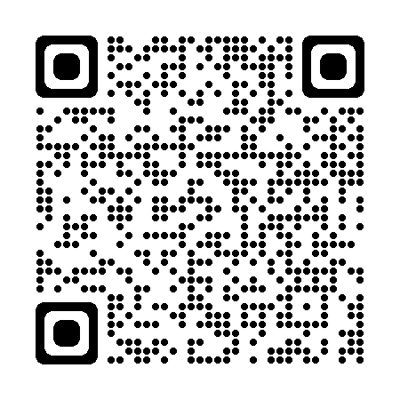
Carer Supports
FAST representatives
FAST – Foster Advocacy and Support Team
FAST – is a primary service delivery area for QFKC
FAST - is funded by the Department of Children, Youth Justice and Multicultural Affairs
FAST representatives are active carers with at least two years caring experience who have been professionally trained and supervised through QFKC to provide support, advocacy and advice to other carers
There is a FAST representative based regionally and who have knowledge and partnerships which benefit their support of other carers
For those areas where there is no FAST representative – simply call QFKC’s office directly, case officers are ready to take your call – 3256 6166

Slide 21

Carer Supports
Financial Support
Fortnightly caring allowance
Regional and remote loading
Child Related Costs (CSSC)
High Support Needs Allowance (HSNA)
Complex Support Needs Allowance (CSNA)
Centrelink (Family Tax Benefit)
Social Supports
Access to support groups and networks
Friends and family
Access to groups – QFKC, FAST representatives
Foster and kinship care groups
Emotional Support
Carer support line
FKC support worker
FAST representative
Short-Break (Respite)
Friends/family & support networks
CSO
Child Safety After Hours Service Centre
Practical Support
FAST representative
CSO
FKC worker
Carer information sheets
Carers business discount card
Information for Carers – website page
Professional development
Learning – carer information fact sheets, journal articles, internet
Training –
  Standard training
  Advanced training
  Targeted training for different skill levels or learning needs
Reflection on role/skills
Foster & Kinship Care agency training
Task focused problem solving support
Specialist advice and assistance
  Psychiatric
  Medical services
  Education services
Facilitating referrals for children to specialist service
Information for carers QR code

Slide 22

Carer Supports
Change in carer circumstances
As part of the team you need to tell Child Safety if you, or any of your household members have any changes in circumstances.
These changes could include:
Household membership –
  a new person wants to join your household (this person must hold a current blue card before they can apply to be a household member) or
  A current household member leaves
Spousal arrangements – new partner (to be living in the home), divorce, separation, death
Any changes in personal history i.e. traffic history, criminal or domestic and family violence history
Involvement by any child protection agency in Australia
Personal circumstances – health issues, employment demands
Change of address – new Household Safety Study will need to be completed
Intention to provide care to other children – relatives, family day care
Complete a Change in Carer Circumstances form and provide it to your CSSC.
A review of your foster carer agreement may need to occur depending on the
changes.
Change in carer circumstances form QR code

Slide 23

Guest Panel and/or
CREATE PowerPoint

Slide 24

Transition to Adulthood

Slide 25
Transition to Adulthood
All young people subject to a CPO granting custody or guardianship to the Chief Executive have the right to receive assistance and support with their transition to adulthood (T2A), to maximise their life opportunities and choices.
T2A planning is integrated into case planning for a young person from the age of 15 years. There isn’t a one-size-fits-all approach to transition planning, and planning should move beyond what the young person needs for their survival and incorporate resilience and life skills. It should be ambitious.
We need to encourage young people to be active in their participation to ensure their transition planning is successful for them. We need to be respectful and proactive in engaging young people—at their pace—in transition planning.

Slide 26
Transition to Adulthood
Young people in care need to have connections to their families, because this provides ongoing relationships and support as they move into adulthood. Relationships with parents, siblings and extended family need to be revisited regularly to find opportunities to strengthen them or reconnect.
It is essential that we establish a robust safety and support network and form partnerships with those in the young person’s network. In the planning process, we use other relationships that the young person may have with professionals or friends. These people can establish effective relationships and assist with communication.
Collaboration delivers better outcomes.

Slide 27

Transition to Adulthood
Child Safety will work with the young person to meet their identified T2A goals, which may include:
  Getting financial assistance for further studies, apprenticeship/traineeship etc.
  Obtaining a driver’s license
  Developing life skills – e.g. cooking or budgeting
  Moving into semi-supported accommodation
  Assisting in applying for TILA (Transition to Independent Living ) payments of up to $1,500

Slide 28
Transition to Adulthood
What carers can do?
Continue to support the young person in your home:
a young person who has been in your care at age 17 can remain in your household once they have turned 18 with Child Safety continuing to pay the fortnightly caring allowance until they leave your household prior to or upon their 19th birthday.
A young person turning 18 who will continue to reside with you past their 18th birthday - and where you will continue to be an approved foster carer – will need to apply for a blue card and complete a New Adult Household Member form.
Support for young people who will be leaving your care prior to, or upon their 18th birthday:
Referrals – assist the young person to access services that can help them in the short term and long term
Assist with T2A planning – with assistance from their CSO, help the young person plan their transition to adulthood
Individual advocacy – advocate on behalf of the young person to ensure they receive the supports they need.
Support – provide emotional and practical support the young person will need for their journey into adulthood and beyond

Slide 29

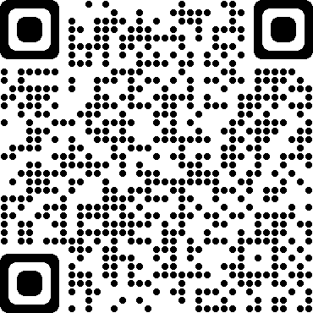
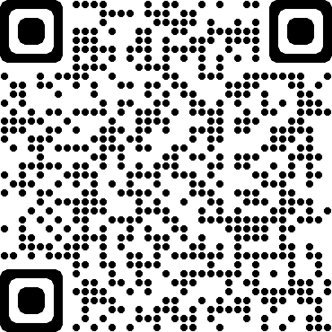




Transition to Adulthood
Resources
There are a range of resources to assist the young person and their care team plan for transition to adulthood:
Sortli app – managed by the CREATE foundation, is a free
mobile app to help young people plan their future, it
has been developed by young people and professionals
who work with young people.
*not suitable for young people under 15.
Android QR code
Apple QR code
CREATE your future
CREATE foundation
Transitioning from care video
resources
CREATE Resources
  Go your own way Info Kit - developed by CREATE – resource
  for young people 15 years and over who are transitioning to adulthood

Slide 30

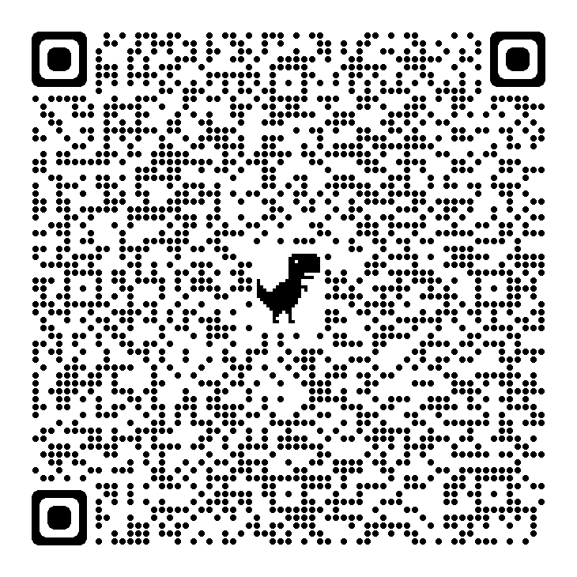


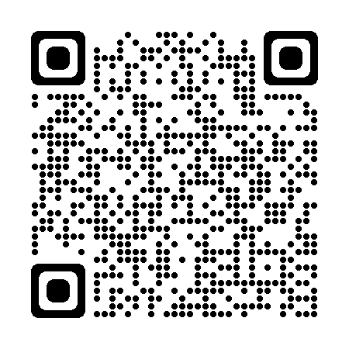
Transition to Adulthood
Qld Health resources
Resources cont.
Understanding PTSD for young people in Care
Department of Social Services
Transition to Independent Living Allowance (TILA) website
Understanding Depression for young people in Care
Next Step Plus will assist young people in care from the age of 15 to develop the skills and knowledge they needs to successfully transition from care to adulthood, and ensure those who have left care are able to receive tailored support, should they need it.
Support from Next Care Plus can be provided to young people up to 25 years
of age.
More information on Next Step Plus can be found at the website below
or click on the QR code to the right.
www.nextstepplus.com.au
Understanding Anxiety for young people in Care

Slide 31
Activity

Slide 32

Saying goodbye

Slide 33

Saying Goodbye
When a care arrangement ends
The child or young person you care for is part of your extended family, but sooner or later that child or young person may leave to either move back home , live on their own or live in another care arrangement.
Planned move from a care arrangement
Planned moves are best for children and young people and also for your family.
Planned moves will involve meetings with you, the child or young person in your care, Child Safety, the care agency support worker and other members of your family if appropriate.
Unplanned move from a care arrangement
Sometimes a breakdown between you and/or your family and the child or young person can occur and moving to a new care arrangement may be the only solution.
Important not to part in anger and when saying goodbye be positive.
Information for carers
When a care arrangement ends

Slide 34
Saying Goodbye
Conclusion of Care arrangement
At the end of a care arrangement, it is important that your valuable information about a child or young person is made available to the person who next cares for them. This should be recorded in a Conclusion of placement form, which your CSO should give you.
It covers a range of information that the carer has first-hand knowledge about:
Significant friendships or significant others in the child or young person’s life
Their relationship with the carers family and their reaction to the care arrangement ending
Hobbies, interests or social activities or sports including swimming ability
Medical and dental information
Scheduled appointments
The personal records that were returned (and to whom)
The key belongings that are going with the child (e.g., computer, bicycle etc.)

Slide 35
Module four: Quality care- Working Together
Learning outcomes- module 4
Demonstrate how all key players can work together - including what to do when things go wrong
Demonstrate an understanding of carer support options
Demonstrate an understanding of transition to independence
Demonstrate an understanding of the complexities of when a care arrangement comes to an end

Slide 36

Reflection
Did anything change from when your first started to now?
Do you have any concerns as a result of the information you know now?

Slide 37

Where to from here for you?
A formal assessment report to be prepared and discussed with you.
Upon completion of your assessment the assessor will make a recommendation to Child Safety to approve or refuse the application
If approved, further training modules are to be completed in your 1st year of caring (3 modules)
Learning journal to reflect on learnings
As an approved carer and after your initial 1st year approval, you will be required to renew your carer approval every 2 years.

Slide 38


