Slide 1

Caring for Jarjums
Strong, proud and safe

Slide 2
Learning outcomes
Identify the experiences and impacts for Aboriginal and Torres Strait Islander people removed from their families and communities under government policies
Describe data relating to the over-representation of Aboriginal and Torres Strait Islander children
Discuss the legislative basis, purpose and elements of the Child Placement Principle
Identify the additional carer responsibilities when providing out-of-home care for Aboriginal and Torres Strait Islander children
Discuss an example of a cultural support plan

Slide 3
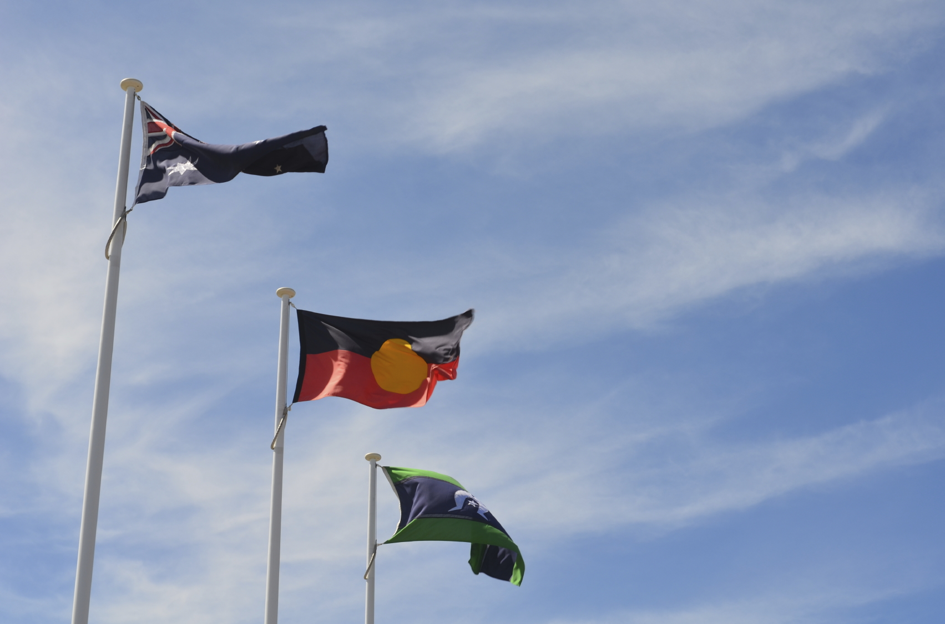
Content of session
Purpose:
To consider culturally sensitive legislative principles and responsibilities when providing out-of-home care for Aboriginal and Torres Strait Islander children.
Content:
The Stolen Generations – experiences and impacts
Child Placement Principle and the Cultural Support Plan
Focus on culture
Putting into practice

Slide 4
Stolen Generations - reflection
At your table, discuss the following questions:
1. What do you know or have heard about the Stolen Generations?
2. What is the source of your knowledge? (from an Aboriginal or Torres Strait Islander person; school/uni; books; TV or film etc)
3. What do you think were some of the differences for the Stolen Generations, if compared to non-Indigenous Australian children who were removed from their families and placed into State care?

Slide 5
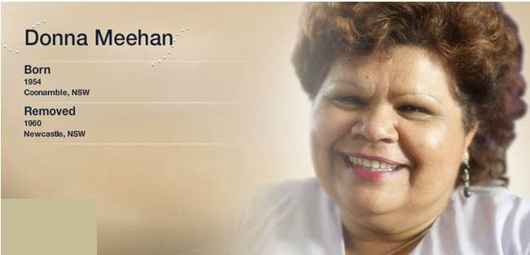
Lessons from the past
Donna Meehan’s testimony
Source: Stolen Generations’ Testimonies http://stolengenerationstestimonies.com/index.php/testimonies/974.html

Slide 6
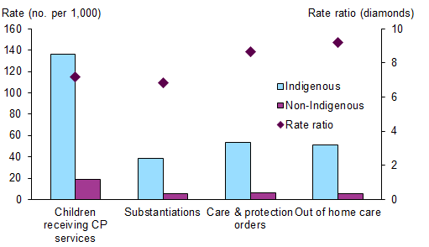
Over-representation
Children in different components of the child protection system by Indigenous status (rate), 2013-14.
Source: Australian Institute of Health and Welfare, http://www.aihw.gov.au/child-protection/children-receiving-services/#indigenous

Slide 7
Mind your language
Aborigines
The acronym - ATSI
Part Aboriginal/Aborigine
Half caste or quarter caste or octoroon
Urban or remote Aboriginal/Aborigine
Aboriginal people/s
Torres Strait Islander people/s
Australian Indigenous
By regional name
  Murri – Qld, north NSW
  Koorie – NSW and Victoria
  Nunga – SA
  Nyoongah – WA
  Anangu – Central Australia
  Palawah – Tasmania
  Yolngu – NT

Slide 8
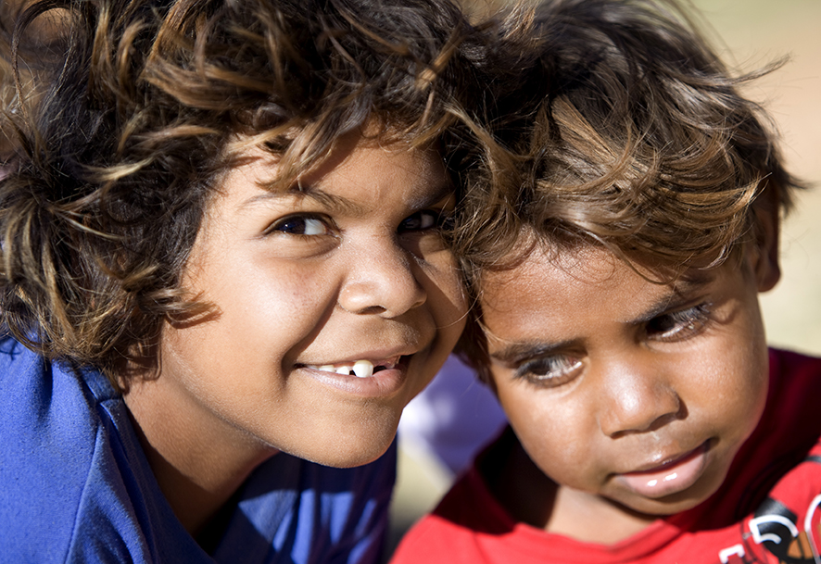
Child Placement Principle
There is a misperception that the child placement principle is only about a placement hierarchy for out-of-home care. It is not simply about where or with whom a child is placed. The history and intention of the Child Placement Principle is about keeping Aboriginal and Torres Strait Islander children connected to their family, culture and community.”
SNAICC ‘Aboriginal and Torres Strait Islander Child Placement
Principles: Aims and Core Elements” June 2013

Slide 9
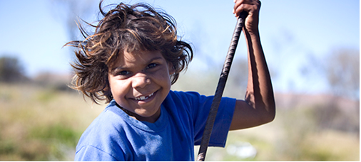
Elements in the
Child Placement Principle
Protecting the cultural rights and identity of Aboriginal and Torres Strait Islander children
Partnering with the Recognised Entities (RE)
Placement prioritisation
Preserving connections with family, community and culture

Slide 10
What does this mean for me?
If you are caring for an Aboriginal and Torres Strait Islander, then you have additional responsibilities. You need to:
Facilitate and support the child’s contact with parents, other family members, as well as their contact with their community/language group (per the child’s case plan)
Help the child to be connected with their culture
Play a role in preserving and enhancing the child’s Aboriginal and/or Torres Strait Islander identity

Slide 11
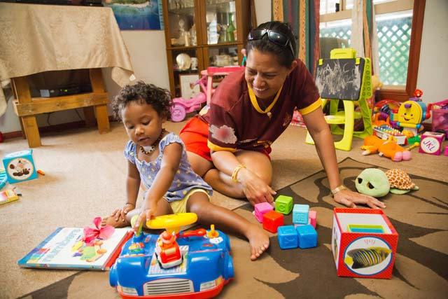
Activity
What do you think?
Discuss the four statements in table groups.
Do you agree or disagree with the statements? Why? Record your thinking/reasons.

Slide 12
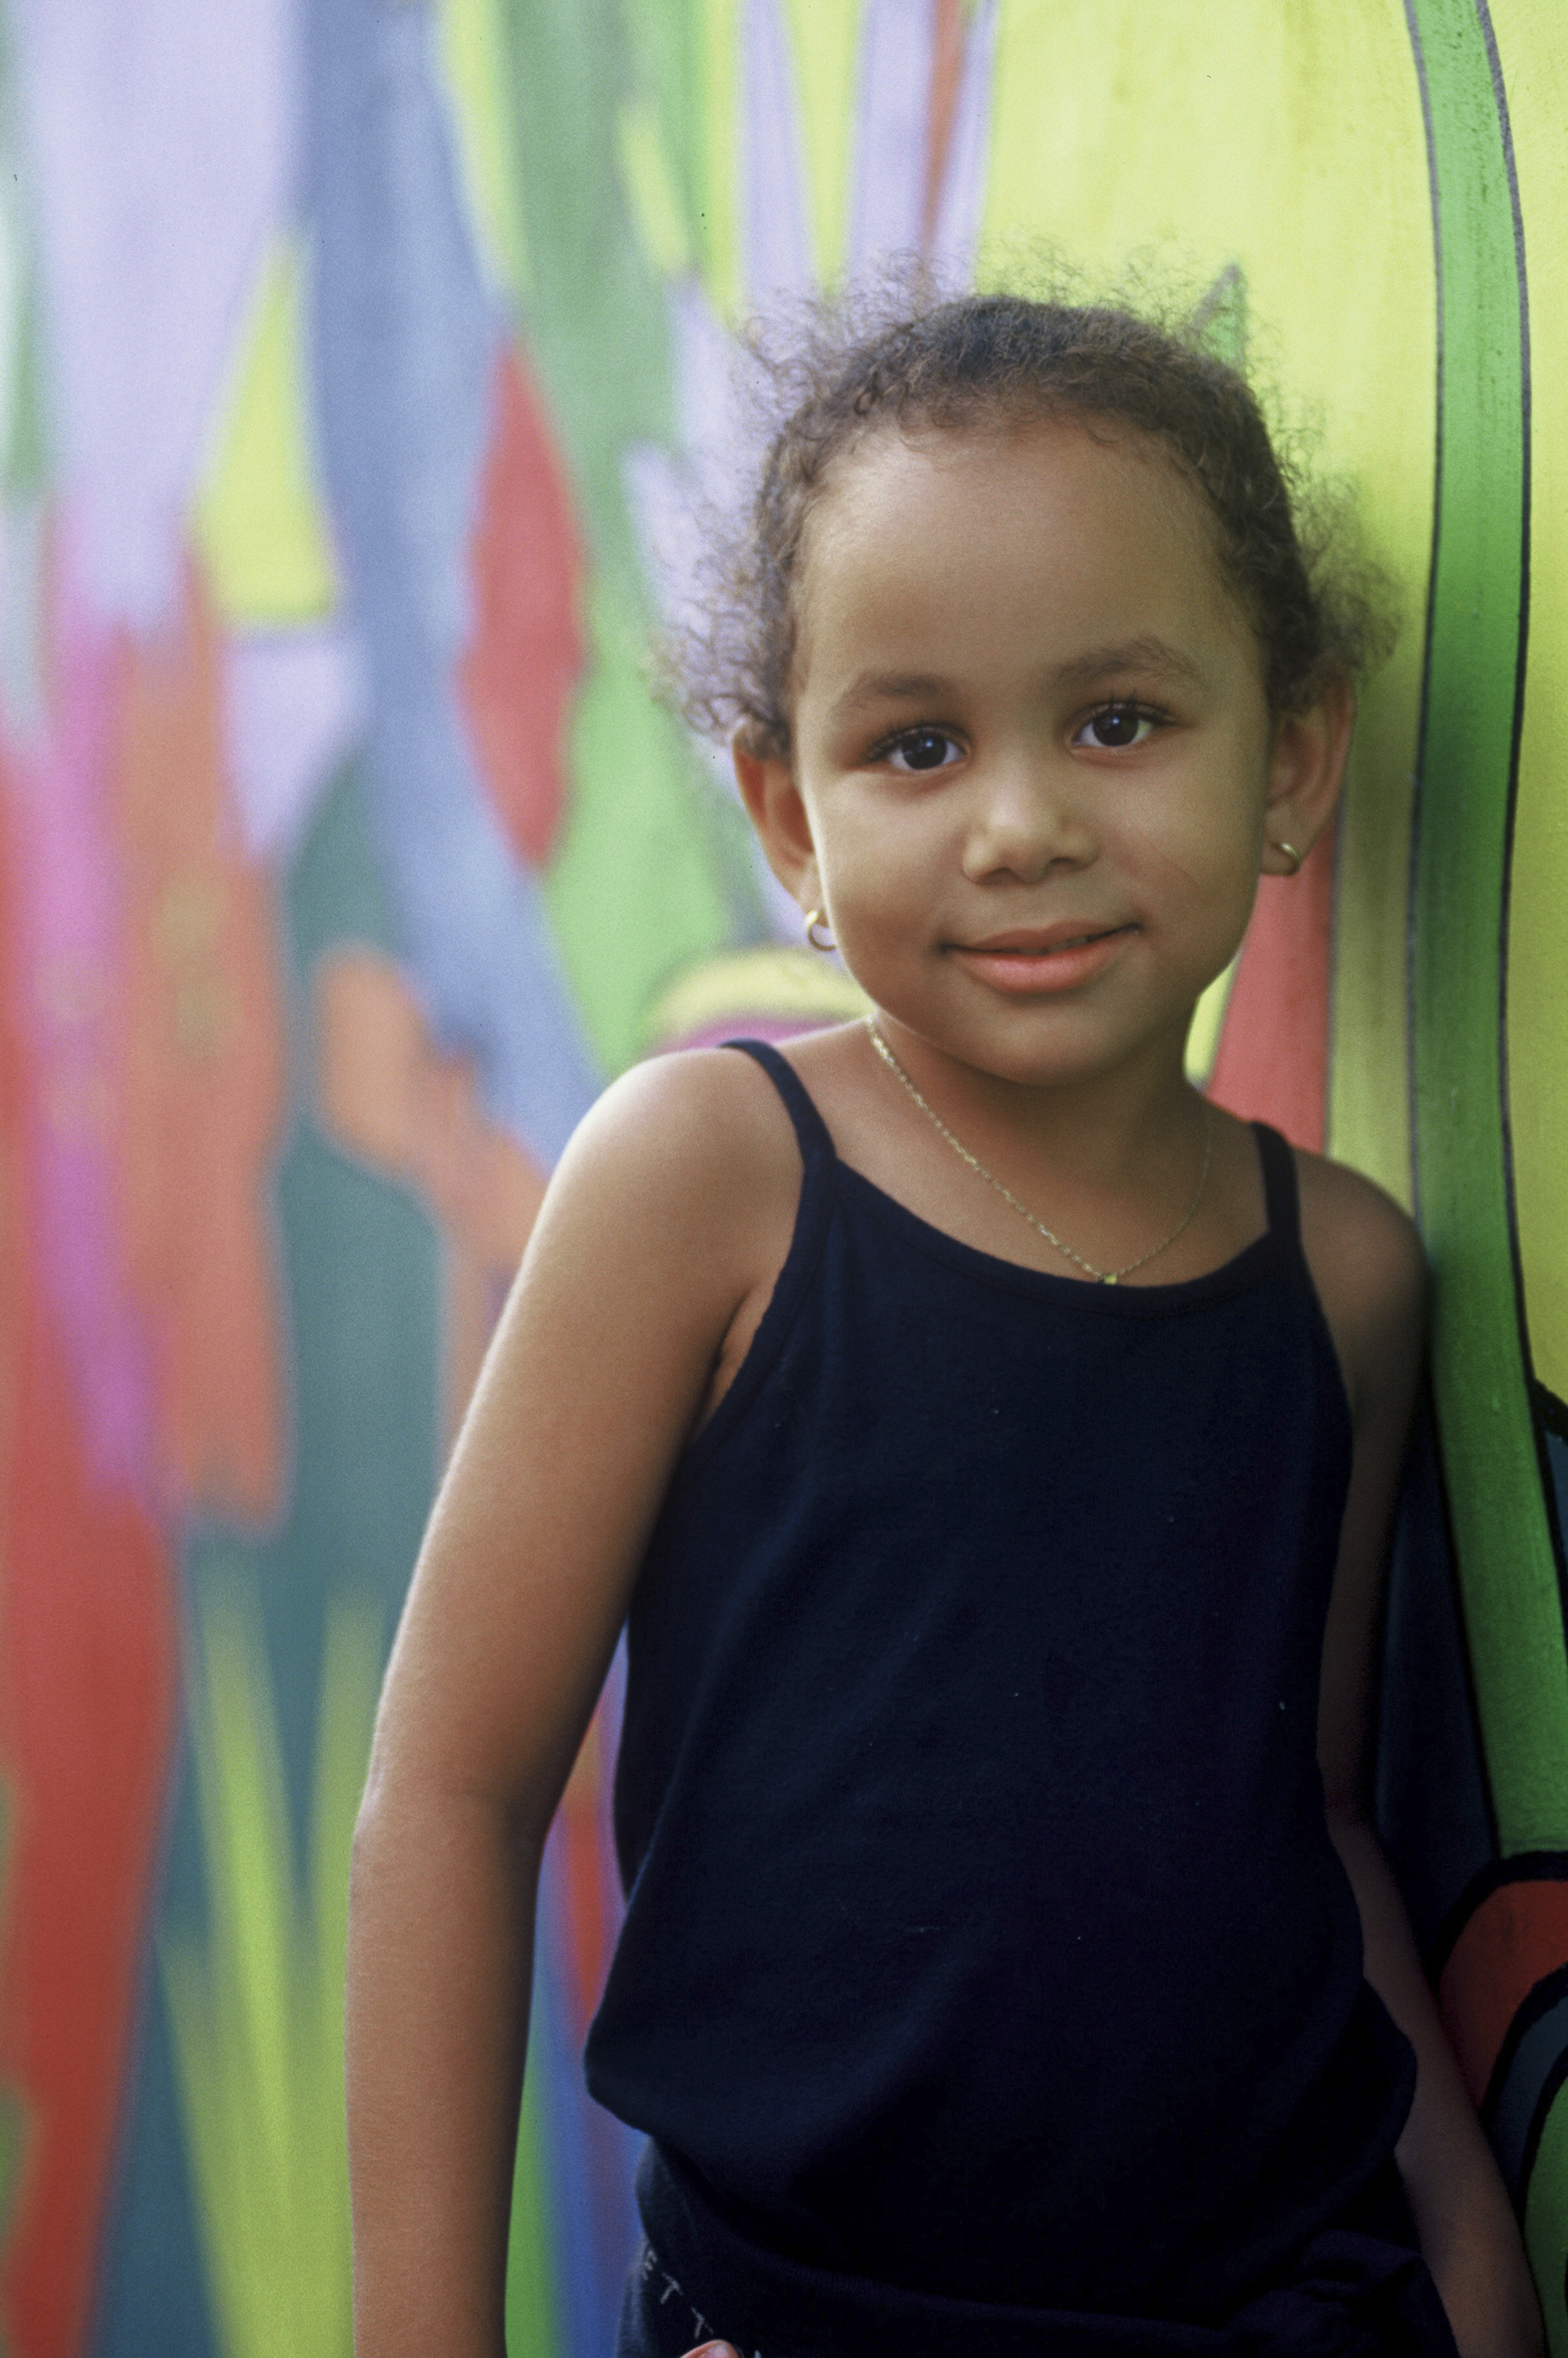
The Starting Point:
The child’s Cultural Support Plan
Records the child’s clan, language/community group
Identifies the activities that will support the child’s sense of cultural identity
Documents the support and help the carer requires in order to maintain/support the child’s culture
Lists others who will be involved in developing the child’s cultural identity

Slide 13
Why is culture important?
“ The best way to ensure that Aboriginal and Torres Strait Islander children in out-of-home care today do not endure the same sense of loss of identity and dislocation from family and community as the Stolen Generations, is to actively support them to maintain or re-establish their connection to family, community, culture and country”.
Source: SNAICC ‘Aboriginal and Torres Strait Islander Child Placement Principles: Aims and Core Elements” June 2013

Slide 14
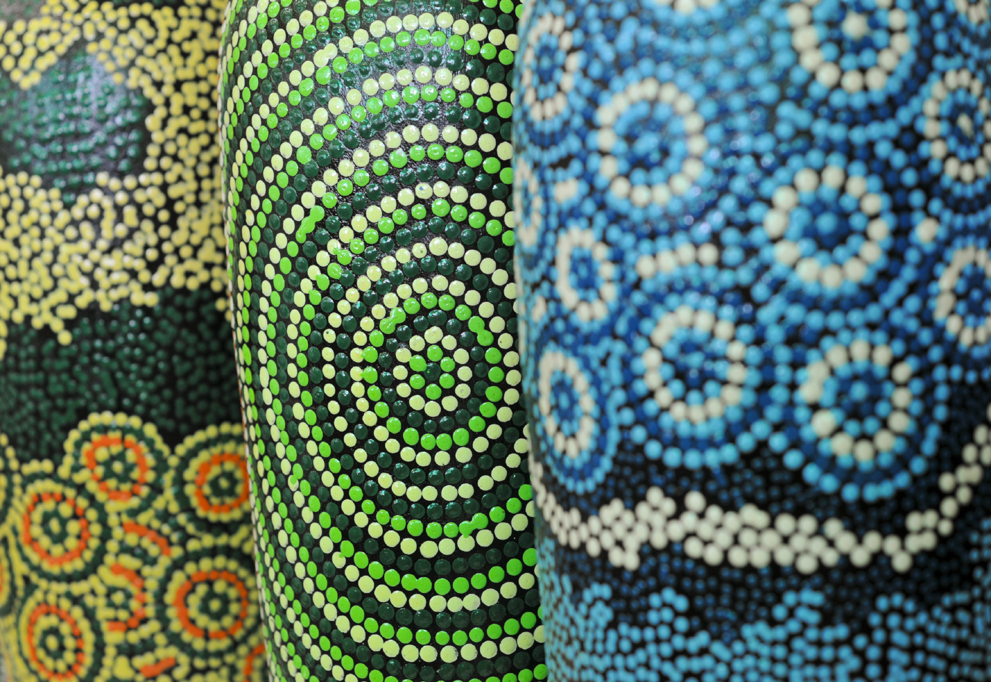
Identity
“Being Aboriginal has nothing to do with the colour of your skin or the shape of your nose. It is a spiritual feeling, an identity you know in your heart. It is a unique feeling that may be difficult for non-Aboriginal people to understand.” Linda Burney of Wiradjuri descent
“We are a community and people by history, spirituality, locations, country, thinking, politics,
treatment, laws, cultures and most
importantly, our stories”.
Readers letter, Koori Mail

Slide 15
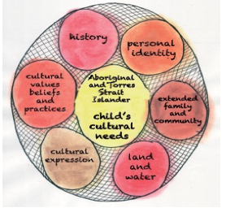
Domains of child’s cultural needs
SNAICC “Aboriginal and Torres Strait Islander Children’s Cultural Needs” 2012 page 2

